Slide 1
שילוב נושאים סוציו-מדעיים ואתיים בלימודי מדע ד"ר יעל שורץ, אתי דגן ואמיל אידיין כנס מורי הכימיה, חנוכה תשע"ו

Slide 2
ENGAGE GOALS
To provide teachers with skills and knowledge as to use RRI teaching strategies
To contribute to students knowledge and skills, attitudes and behaviors that allow them to engage effectively with RRI-based science as future citizens and in their own lives.

Slide 3
ENGAGE strategy for teachers
Adopt - combines exciting learning materials, online community, online courses and workshops for coaching and feedback.
Adapt - offers opportunities for teachers to adapt and design their own RRI materials.
Transform- provides open-ended projects to put teachers and students into partnership with practicing scientists, to learn about RRI directly.

Slide 4
The project Theoretical framework
Development of ready-to use classroom materials
Developing a tool-kit for teachers including
Dilemma tool
Group Discussion
Problem-solving sequence
Class conversation
Scenario-based topic
Performance assessment
Developing on-line and face to face teachers professional development programs

Slide 5
Framework for curriculum development
Science big ideas
RRI context
Ideal RRI skill
Proposed Performance expectation

Slide 6
Example of RRI skills:
Critique claims
Weigh up issues: Compare solutions, Estimate risks
Examine consequences, discuss limitations, Draw conclusions,
Communicate ideas
Argue an opinion
Interrogate sources
Use ethics

Slide 7
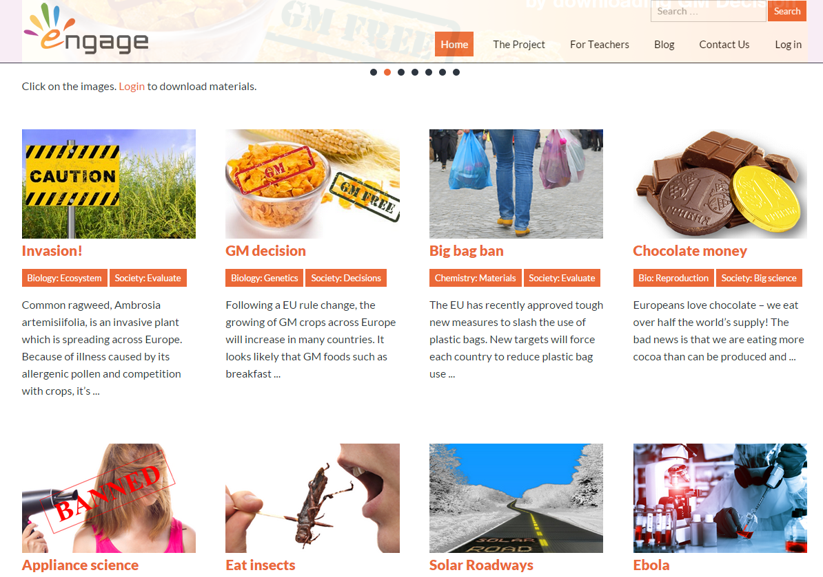
Our dilemma-focsused classroom materials
Check Our site
http://www.engagingscience.eu/

Slide 8
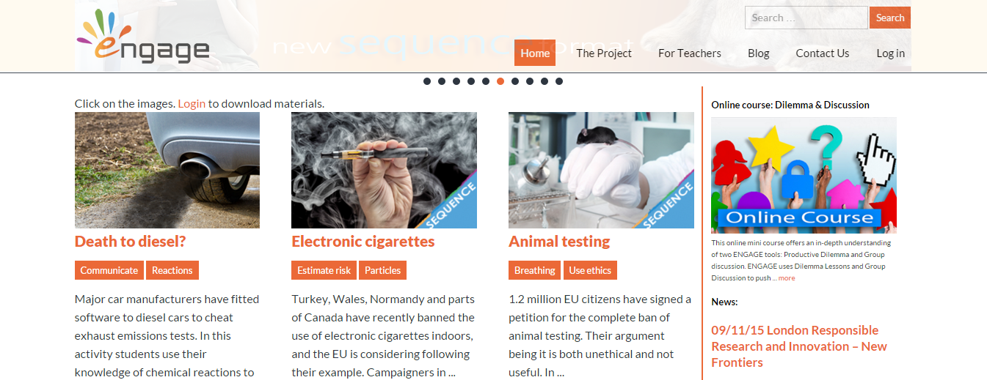

Slide 9

Criteria | The Dilemma should be ...
engaging | Interesting to most students. It has a 'hook'. Hooks are stories with strong human interest: popular topics with boys/girls, concerns about the future, lifestyle, disasters, celebrities
authentic | a real question, choice, or action that students might consider in response to news in the media about emerging science or technology
controversial | should not be an obvious choice or action for students, in order to merit thought and discussion.
covered | an issue that requires the use of science in its resolution, which applies knowledge that is part of the national curriculum (or equivalent), at an appropriate age-level
social | a decision-making scenario, based on scientific knowledge influences the life on the individual including the impact on society, environment, economy etc.
RRI | a problem that requires an inquiry process (RRI) e.g. technology, big science, values thinking, scientific media, define problems, evaluate solutions, construct arguments, critique arguments , interrogate media, communicate ideas.
Source: ENGAGE PROJECT (2014-2016)

Slide 10

Example of ENGAGE dilemma lesson - EBOLA
engaging | Hooks (disaster): Ebola can spread quickly with devastating consequences
authentic | Scientists are developing drugs and vaccines to help fight it
controversial | Students are asked if they would trial a new Ebola vaccine
covered | - Working Scientifically: Scientific attitudes: Evaluate risks - Biology: Inheritance, chromosomes, DNA and genes: a simple model of chromosomes, genes and DNA in heredity
social | - Weigh up risks and benefits and make a decision - Use scientific knowledge of the function of genes.
RRI | - Develop scientific thinking: evaluate personal, social, economic and health implications - Make decisions based on the evaluation of evidence and arguments; - Evaluate risks both in practical science and the wider societal context
Source: ENGAGE PROJECT (2014-2016)

Slide 11
What are the teachers’ role in ENGAGE dilemma lessons? to help students
 | capture their attention with the context activate previous or informal knowledge Be curious and appropriate the dilemma’s learning objectives as their goals
 | Use their relevant knowledge to solve the problem. Apply their inquiry (RRI) skills to find solution. Justify an overall decision or evaluation.
 | Get feedback to improve their performance. Reflect on what they learned from the lesson and how.
ENGAGE
EXTEND
EVALUATE

Slide 12
What are key strategies in ENGAGE dilemma lessons?
 | Find out about the new story to become enthusiastic yourself Make the context more dramatic using props or demonstrations Ask questions to relate the Dilemma to students’ experience Get students to compare their reactions to the question
 | Listen in to group discussions Ask questions to check understanding Remove scaffolding in student sheet for more advanced students Support students in interpreting sources of evidence Support students in justifying their response to the dilemma
 | Use formative assessment techniques to assess students’ understanding Get students to self- or peer- assess the outputs Ask students what was easy or difficult in the task, and how they solved the problem
ENGAGE
EXTEND
EVALUATE
Source: ENGAGE PROJECT (2014-2016)

Slide 13













ENGAGE CONSORTIUM
ENGAGE CONSORTIUM includes 14 Institutions from 12 countries with extensive experience in IBSE, RRI, teacher training, and curriculum design

